Slide 1
CMSC 201 Computer Science I for Majors Lecture 02 – Intro to Python

Slide 2
Last Class We Covered
Syllabus
Grading scheme
Academic Integrity Policy
(Collaboration Policy)
Getting Help
Office hours
Programming Mindset
“Failure” (isn’t really failure)

Slide 3
Any Questions from Last Time?

Slide 4
Today’s Objectives
To start learning Python
To learn about variables
How to use them
Different types
To learn how to use input and output
To do interesting things with our program
Written programs vs Python interpreter

Slide 5
Variables

Slide 6
Python
Python is a widely used language
General purpose
High-level language
Emphasizes code readability
More streamlined than some other languages

Slide 7
“Hello World!”
In Python:
print("Hello World!")
In the C++ programming language:
#include <iostream>
int main() {
std::cout << "Hello World!\n";
}

Slide 8
Elements of a Program
Identifiers
Variables
Functions (later in the semester)
Expressions
Code that manipulates or evaluates identifiers
Literals
Operators

Slide 9
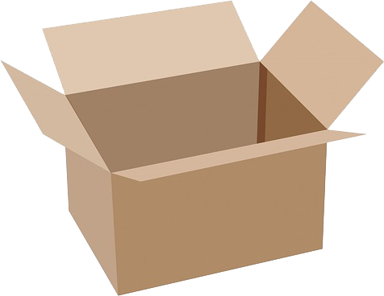
What Is a Variable?
Something that holds a value
Can change (unlimited number of times)
Similar to variables in math
In simple terms, a variable is a “box” that you can put stuff in

Slide 10
Rules for Naming Variables
Variable names can contain:
Uppercase letters (A-Z)
Lowercase letters (a-z)
Numbers (0-9)
Underscores (_)
Variables can’t contain:
Special characters like $, #, &, ^, ), (, @

Slide 11
More Rules for Naming Variables
Variables can be any length
x
IsKanyeRunningForPresidentIn2020
myName
Variables cannot start with a digit
2cool4school is not a valid variable
cool4school is a valid variable

Slide 12
Variables and Keywords
Keywords are “reserved” words in Python
Variables cannot be keywords
or is not a valid variable name
orange is an acceptable variable name
False | class | finally | is | return
None | continue | for | lambda | try
True | def | from | nonlocal | while
and | del | global | not | with
as | elif | if | or | yield
assert | else | import | pass
break | except | in | raise

Slide 13
Exercise: Variables
Are the following legal or illegal in Python?
1spam
raise1
Spam_and_Eggs
EXIT_CODE

Slide 14
Exercise: Variables
Are the following legal or illegal in Python?
1spam
No – Illegal!
raise1
Yes – legal!
Spam_and_Eggs
Yes – legal!
EXIT_CODE
Yes – legal!

Slide 15
Exercise: Variables
Are the following legal or illegal in Python?
Spam_and_Eggs
Yes – legal!
But it doesn’t follow our coding standards!
spamAndEggs or
spam_and_eggs

Slide 16
Using Variables in Python
You create a variable as soon as you declare it
You also need to initialize it before using it
Use the assignment operator (equal sign)
mascotUMBC = "dog"
newStudents = 1538
dogsAreGood = True
assignment operator

Slide 17
Expressions

Slide 18
Expressions
Programs manipulate data
Allows us to do interesting things
Expressions calculate new data values
Use assignment operator to set new value

Slide 19
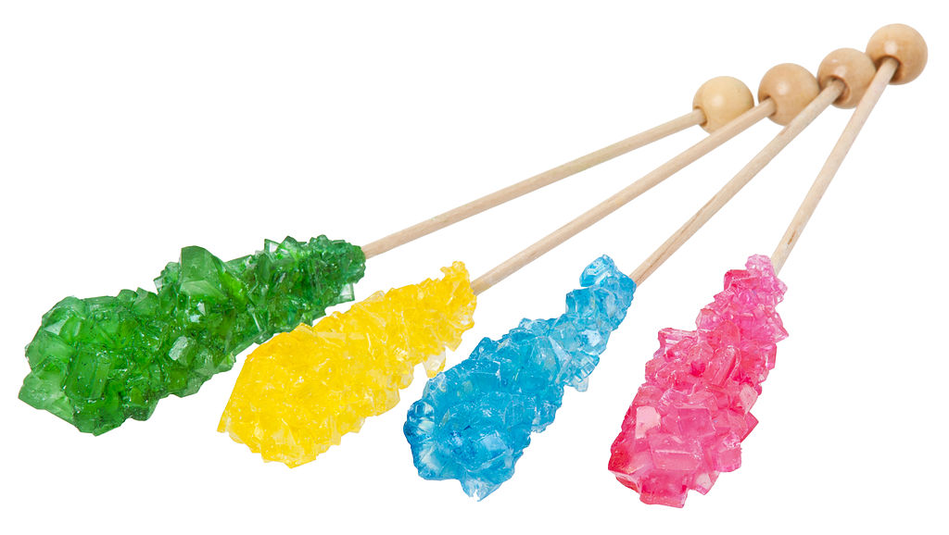
Expressions Example
numCandy = 4
priceCandy = 0.58
totalCost = numCandy * priceCandy
variable being set
assignment operator
value (a “literal”)
expression

Slide 20
Common Mistake
Many new programmers mix up the left and right hand sides of the assignment operator
Variable being set must be on the left
Expression is on the right
Evaluate the expression first, then assign the value
✓
numCandy = 4 + 1
✗
4 + 1 = numCandy

Slide 21
Variable Types
There are many different kinds of variables!
Numbers
Whole numbers (Integers)
Decimals (Floats)
Booleans (True and False)
Strings (collections of characters)

Slide 22
Variables Types: Examples
aString = "Hello class"
float_1 = 1.12
myBool = True
anInteger = 7
dogName = "Ms. Wuffington"
classCode = 201

Slide 23
Variable Usage
Variables are designed for storing information
Any piece of information your program uses or records must be stored in a variable
Python doesn’t have a “short term memory,” so everything needs to be written down for it

Slide 24
Literals and Operators

Slide 25
Literals
Literals in Python are values you use “literally”
Can be assigned to a variable or not
For example:
2 is an integer literal
“Hello” is a string literal
4.0 is a float literal
False is a Boolean literal

Slide 26
Using Literals
The expression below assigns the string literal “CMSC” to a variable called major
major = "CMSC"
The expression below prints the integer literal 50 without assigning it to a variable
print(50)

Slide 27
Operators
Operators are special symbols that allow Python to perform different operations
There are many types of operators
Mathematical
Comparison
Assignment
Logical

Slide 28
Operator Types
We won’t cover all the types in detail today, but here are some simple examples
Mathematical
+ - * / %
Comparison
< <= != >= ==
Assignment
= += *=
we’ll cover the “weird” ones later

Slide 29
Practice Exercises
Print the value of the variable myDog
Remember to assign a value to myDog first!
Set a value for a variable called bill, and calculate and print the 15% tip for that bill
Create your own expression using at least two variables, and print out the result

Slide 30
Input and Output

Slide 31
Output
Output is text that is printed to the screen
So the user can see it
The command for this is print
Use the keyword “print” and put what you want to be displayed in parentheses after it

Slide 32
Output Example
print (3 + 4)
print (3, 4, 3 + 4)
print()
print("The answer is", 3 + 4)
7
3 4 7
The answer is 7
What does this output to the screen?

Slide 33
Output Exercise 1
What will the following code snippet print?
a = 10
b = a * 5
c = "Your result is:"
print(c, b)
Your result is: 50

Slide 34
Output Exercise 2
What will the following code snippet print?
a = 10
b = a
a = 3
print(b)
10
There are a few possible options for what this could do! Any guesses?

Slide 35
Output Exercise 2 Explanation
Why does it print out 10?
When you set one variable equal to another, they don’t become linked!
They are separate copies of a value
After b is set to 10, it no longer has anything else to do with a

Slide 36
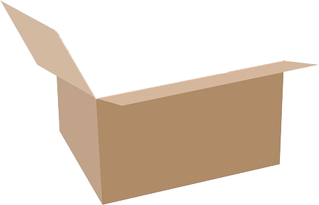
Output Exercise 2 Explanation
a = 10
b = a
a = 3
print(b)
10
a

Slide 37
Output Exercise 2 Explanation
a = 10
b = a
a = 3
print(b)
10
10
a
b

Slide 38
Output Exercise 2 Explanation
a = 10
b = a
a = 3
print(b)
3
10
10
a
b

Slide 39
Output Exercise 2 Explanation
a = 10
b = a
a = 3
print(b)
output:
10
3
10
a
b

Slide 40
Input
Input is information we get from the user
We must tell them what we want first
userNum = input("Please enter a number: ")
print(userNum)
The input and output will look like this:
Please enter a number:
22
22

Slide 41
How Input Works
userNum = input("Please enter a number: ")
Takes the text the user entered and stores it
In the variable named userNum
You can do this as many times as you like!
userNum = input("Enter another number: ")
userNum2 = input("Enter a new number: ")
userAge = input("Please enter your age: ")

Slide 42
Input as a String
Everything that is stored via input() will come through in the form of a string
There is a difference between "10" and 10
"10" is a string containing two characters
10 is understood by Python as a number

Slide 43
Converting from String
To turn an input string into a number, you can do the following:
aNum = input("Enter a number: ")
aNum = int(aNum)
“int” stands for “integer” (a whole number)
You can also do it in one line:
aNum = int(input("Enter a number: "))

Slide 44
Converting from String
We can cast to other data types as well
gpa = float(input("Enter GPA: "))
Do you think the string "1,024" will work if we try to cast it as an integer? Why?
It won’t work
The comma character isn’t a number

Slide 45
Written Programs vs Python Interpreter

Slide 46
We Started Python Today!
Two ways to use Python
You can write a program as a series of instructions in a file and then execute it
You can also test simple Python commands in the Python interpreter
We will write programs for assignments
Use the interpreter to help you test things

Slide 47
Written Programs
Create, write, and save a Python file (.py)
File is run via the command line
python myProgram.py
File must be complete to run correctly
Program cannot be edited on the fly
Must be exited, file re-opened, changes made, file saved and closed, and then re-run the program

Slide 48
Python Interpreter
The “interactive” interpreter evaluates each individual line of code as it’s typed in
Type “python” to launch the interpreter
>>>
Hello
>>>
11
>>>
print("Hello")
4 + 7
>>> is where the user types their code
lines without a “>>>” are Python’s response

Slide 49
Reminder: Python 3
Don’t forget to enable Python 3 before you run any code, whether in a program, or via the Python interpreter
Type “scl enable python33 bash” to turn on Python 3
Type “exit” to exit Python 3 (or GL entirely)
Type “exit()” to exit the interpreter

Slide 50
Time For…
LIVECODING!!!

Slide 51
Daily emacs Shortcut
CTRL+X, CTRL+S
Saves the file and stays in emacs
Allows you to keep editing the file
CTRL+X, CTRL+C
Closes emacs, does not automatically save the file
Will prompt you to save if changes were made

Slide 52
Announcements
Your discussions (Labs) start next week!
Go to your scheduled location and time
Pre Lab quiz will be posted and announced on BB
Lab 1 is due Sunday, February 4th at 8:59:59 PM
In-person labs start the week of February 5th
HW 0 is due Friday, February 9th at 8:59:59 PM

Slide 53
Image Sources
Cardboard box:
https://pixabay.com/p-220256/
No cursing sign (adapted from):
https://www.flickr.com/photos/rtgregory/1332596877
Rock candy:
https://commons.wikimedia.org/wiki/File:Rock-Candy-Sticks.jpg
Broken chain:
https://pixabay.com/p-297842/

